Slide 1

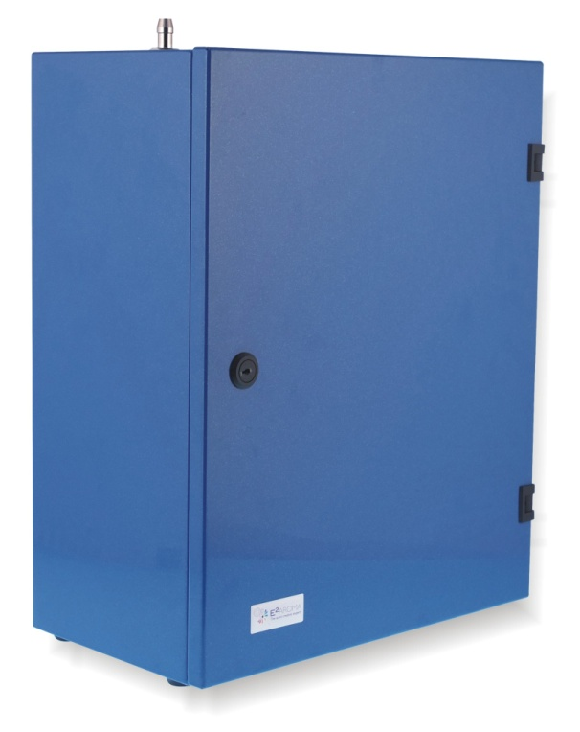

F
Aero Diffusion
Technical Specifications
CryptoScent®

Slide 2
Table of Contents
Introduction p.1
Technology p.5
Precautions p.6
General Maintenance p.7
Programming p.8
Installation p.13
Specifications p.19
Aero Diffusion
Technical Specifications 2014
2

Slide 3
Introduction
Aero Diffusion Technology® can be applied by 3 different devices that cover every need. The devices have been designed in order to respond to the demands of any project or area. They are fully programmed and ergonomical.
Aero Diffusion
Technical Specifications 2014
3

Slide 4
CryptoScent®
CryptoScent® has been designed in order to aromatize any kind of large scale spaces through the central ventilation system. It can be applied directly on the HVAC or to the supply duct of the central air-conditioning system.
CryptoScent® ensures 100% area coverage of large spaces and is suggested in highly demanding projects.
Aero Diffusion
Technical Specifications 2014

Slide 5
Technology
Aero Diffusion appliances of Spring Air thanks to the patented diffusion system that they use, they can ensure the conversion of the liquid fragrance into ultra fine droplets ,distributing them at an average of 1.000 nanometers (1 micrometer μm) in diameter.
What can be characterized as being unique concerning the Aero Diffusion Technology® is the small droplet diameter and the extra light weight of the droplet that can ensure uniform scent distribution.
In performance terms, Aero technology droplets convert liquid into vapor very fast. This ensures the absence of residues on surfaces within the scented area. Very important parameter is that the scent effect, which is created, cause very low concentration of fragrance in the air, usually less than 1PPM which is below the international standards for allergic response.
The perfect diffusion of the fragrance into the area can be achieved with the complete programming of the devices. Each device can be programmed for every day separately into two different zones. Thus, given that capability, the aromatization of each space is feasible.
Aero Diffusion
Technical Specifications 2014
5

Slide 6
CryptoScent® Appliance Precautions
The appliance must be operated in an upright or vertical position and firmly attached to a vertical surface such as a wall or a duct.
The appliance should NOT be used with the door in the open position. The door is opened only to perform a cartridge or program change.
NEVER put your nose to the output of CryptoScent®. Within 12 inches of the output, the fragrance is highly concentrated. The improper inhalation of high concentrations of fragrance may cause irritation in eyes and respiratory.
The appliance is built to be plugged into an 110VAC or 220VAC power outlet. The UL and CE compliant power supply converts power to 12V DC to power the appliance.
Unplug before cleaning
Aero Diffusion
Technical Specifications 2014
6

Slide 7
General Maintenance
Changing the Cartridge
Unlock and open the door to access the cartridge: The door should be opened only to perform a cartridge or programming change. When in use, the doom must be locked.
Detach metal hose connector from the cartridge output port (located on the top of the cartridge head). This is done by unscrewing the metal connector from the cartridge output port and pulling out.
Remove air nozzle (located on the top of the cartridge head)
Remove old cartridge from appliance enclosure
Insert air nozzle on the new cartridge
Install new cartridge, place and tighten metal hose connector firmly on cartridge output port
Close the door and the device to secure
Aero Diffusion
Technical Specifications 2014
7

Slide 8
Programming
Day & Time programming
We press CLOCK and the indication HOUR is displayed. Using the + button we set HOUR
Aero Diffusion
Technical Specifications 2014
2) We press and the indication MINUTES is displayed. Using the + button we set MINUTES
3) We press . The days of the week will be shown on the screen. Using the + button we move the cursor to the current day
4) We press SET and the day & time programming has been completed
8

Slide 9
Programming
24-hour programming
We press 24/7 for 3 seconds and the indication 00 is flashing in the right part of the screen
Aero Diffusion
Technical Specifications 2014
2) Using the + button we choose one of the 49 intensity options that device programming can give us
3) We press SET and the 24-hour programming has been completed
Note: The device has 49 pre-installed programs in which the fragrance intensity can be adjusted. For example , in program 01 the intensity of the fragrance is the lowest and in the program 49 is the highest
9

Slide 10
Programming
Daily customized programming
Aero Diffusion
Technical Specifications 2014
We press PR button for 3 seconds and we have the days of the week on the screen. Using the + button we move the cursor among the days and with the button we underline the days that we want to function
We press SET and the indication is ON1 for the chosen days from step 1. Using the + button we adjust the time in which we want the device to start operating and we press
Using the + button we adjust the minutes of the starting working hour of the device
3) We press SET and the indication is OFF1 for the chosen days from step 1. Using the + button we adjust the time in which we want the device to stop operating and we press
Using the + button we adjust the minutes of the ending working hour of the device
(Continue on page 11)
10

Slide 11
Programming
Daily customized programming
4) We press SET and the indication 00 is flashing in the right part of the screen for the days we have chosen. Using the + button we choose one of the 49 installed programs (intervals) of the fragrances intensity
Aero Diffusion
Technical Specifications 2014
5) We press SET and we have the remaining days on screen that need programming. Using the + button we move the cursor under these days and with the button we underline the days that we want to adjust
6) We repeat STEPS 2,3, 4 and 5 until to complete all the days of the week
a) Note in the step 4 of the programming: After the adjustment of the Interval if we choose SET and at the same time button instead of SET only, we have the indication ON2 for the chosen days. Repeating steps 2,3 and 4 we can program a second function zone for the chosen days
b) In case we want for day the device to be OFF ex. Sunday we program the Internal 1 00 for that specific day.
(Continue from page 10)
11

Slide 12
Programming
STEPS
We press CLOCK and the indication HOUR is displayed. Using the + button we set HOUR
Aero Diffusion
Technical Specifications 2014
2) We press and the indication MINUTES is displayed. Using the + button we set MINUTES
3) We press . The days of the week will be shown on the screen. Using the + button we move the cursor to the current day
4) We press SET and the day & time programming has been completed
12

Slide 13
Installation
It is important to find an insertion point where the plume output will be smoothly drawn into and mixed with the airflow. This usually means those parts of the AHU where the static pressure is negative. Ideal locations include:
Before the supply fan with injection through the wall of the AHU. Positioning immediately before the fan and after the coils if possible or in the mixed air chamber.
Outside the AHU in the Supply duct.
Best practice when installing in an AHU is to place the injection tube after the heating and cooling coils. If this not possible, the Plume output can pass over hot water, steam, chilled water, and DX coils.
Aero Diffusion
Technical Specifications 2014
13

Slide 14
Installation
The best location for the Appliance is below the injector tube. The injector hose should be run upward as short a distance as possible and NEVER MORE THAN 20 cm. If an upward injector hose run is not possible, care should be taken support the hose to prevent sagging or any low spot in the run to avoid any possibility of condensation and liquid collection which will block the plume output. Give the hose a light upward slant along its run. The hose must not be run horizontally. A strong tape (such as Venture tape) may be used to support short runs.
Aero Diffusion
Technical Specifications 2014
14

Slide 15
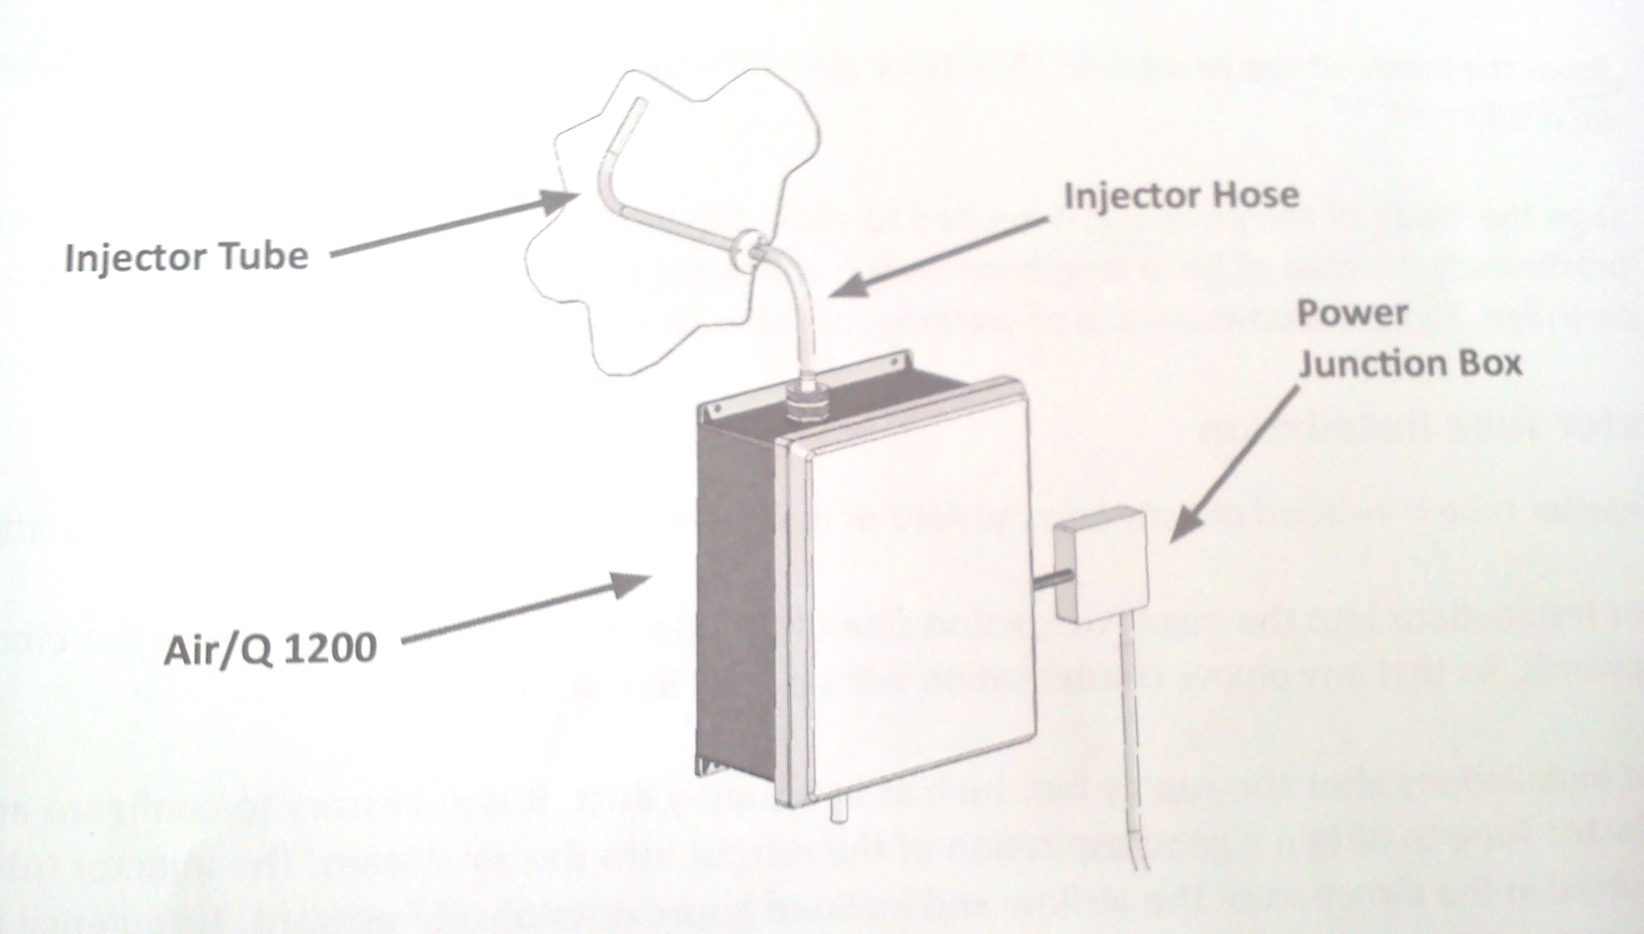
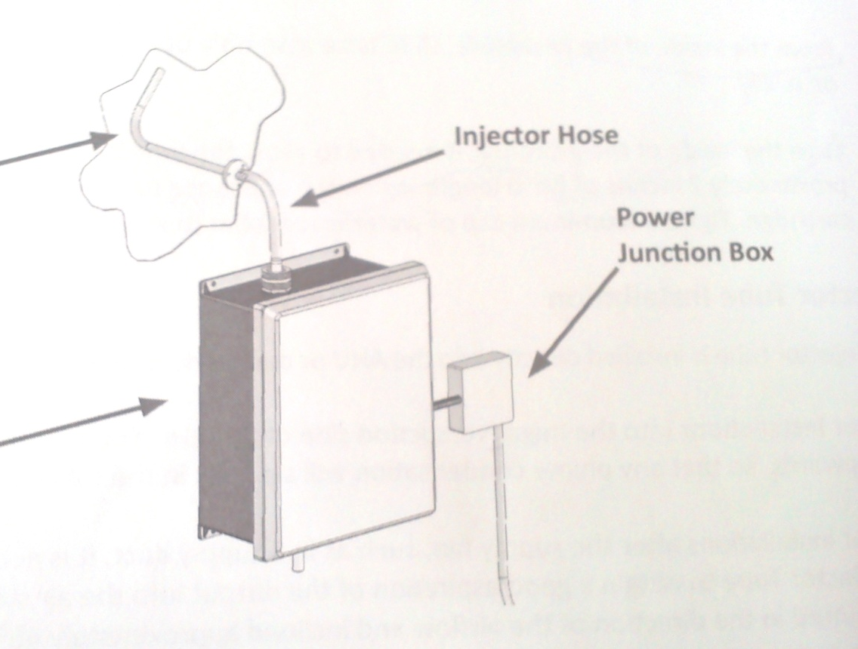
Installation
Aero Diffusion
Technical Specifications 2014
Injector tube
CryptoScent ®
15

Slide 16
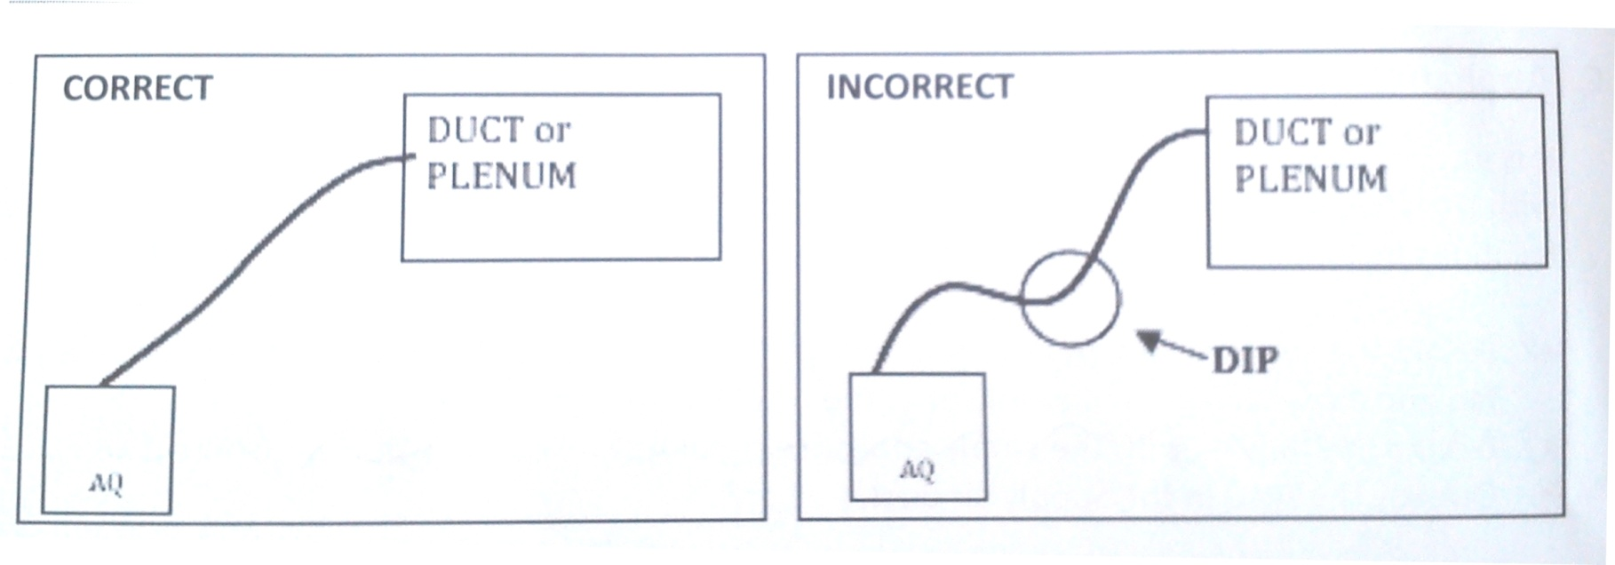
Installation
Aero Diffusion
Technical Specifications 2014
16

Slide 17
Installation
The appliance is wall- mounted. Place the appliance onto the desired location on the wall or AHU and ensure that is level.
Fasten the metal base of the appliance to the wall or AHU using necessary screws.
Connect the power cord to a junction box or attach an AC plug to the cord and connect to a nearby outlet
Secure the appliance
Injector Tube installation
The injector tube is installed directly into the AHU or ductwork. Its orientation can be adjusted relative to airflow.
For installations into the negative/ suction side of the AHU fan, orient the tube with the elbow pointed upwards, so that any plume condensation will sip back in the tube.
Aero Diffusion
Technical Specifications 2014
17

Slide 18
Installation
For installations after the supply fan, such as in a supply duct, it is necessary to configure and orient the Injector Tube to obtain a good aspiration of the output into the air stream. The injector tube should be pointed in the direction of the airflow and inclined approximately 45° upward. Turbulence in the airflow can prevent even aspiration of the plume. It is best to place the tube in a straight section of duct, and far away from turns. Branches, or cross- section changes as practical, and not immediately after the supply fan.
At the insertion point, drill a hole using a ½“ drill bit.
Insert the Injector Tube through the hole
Find an orientation of the injector Tube that appears to produce a good draw of air into the end of the barb.
Fasten the flange using the three #10 sheet metal screws.
Turn the appliance on and verify that a plume is produced
Attach the Injector hose into the hose barb of the Injector Tube
Aero Diffusion
Technical Specifications 2014
18

Slide 19
Specifications
CryptoScent®
Technical Characteristics
Reference CryptoScent®
Type Cold Evaporation Diffusion device
Diameter of particles 300nm to 1μ micron
Power Input
Input 100 - 240 VAC at 0.6 A
Frequency 50/60 Hz
Protection Switching power supply
Internal Power 12 VDC at 1.5 A
Back-up battery Lithium 3V, #CR2032
Performance Up to 4.000 m² subject to air flow conditions
Control Programmable start & stop times
Programmable output 1 to 49
Dimensions
Height x width x depth 37cm x 28cm x 20cm
Weight with full container 6,600 kgs
Cartridge
Reservoir 1000ml
Disposable/Recyclable
Patented Spring Air
Aero Diffusion
Technical Specifications 2014
19

Slide 20
Revolutionary solutions
for different
needs…

